Slide 1




Nature and Health Policy Internship
Rohini Achal

Slide 2








About the Intern
MAJOR:
MINOR:
Notes:
Got into public health because of the systems approach to population health, interdisciplinary
Got into public policy because I had an interest in policy to begin with but wasn’t ready to dive headfirst into political science or something super intensely related to being a politician
Declared it as my minor during my second year after my intro class because it was so interesting and felt really relevant to public health
Interests are: long-term care, education equity, reproductive health/justice, and environmental/climate justice
Why I chose EarthLab:
To expand my knowledge of environmental equity and justice issues as well as justice-based climate solutions
To learn new skills related to the workplace and the climate justice sector from and with peers

Slide 3




Internship Site: Nature & Health
Notes:
History:
2014: Established as a group
2018: Official funding from REI & launched under UW EarthLab
2021: Grown to 360+ researchers, practitioners, policymakers, etc.
Still growing + seeking outside help w/ interns!
Activities:
Provide a space for researchers to communicate with others about findings
Dissemination of the findings
Lunchtime talk series, dinners with communities, annual conference
Researcher to researcher w/ practitioner level
Goals:
To understand the connections between nature contact and human health and wellbeing
To translate that understanding into different programs, practices, policies and the design of healthcare, educational, and community settings that benefit all people and nature

Slide 4


N&H Final Project Overview
Aim
Goal
Internship: Identify opportunities for N&H to get involved in local and state policy initiatives
Peronal: Grow my career experience and practice being in a professional environment
Internship: Create an internal document for N&H steering committee
Personal: Grow my skills in policy synthesis, concise scientific communication
Notes:
I had an aim and a goal for both the internship and for my personal growth

Slide 5

N&H Final Project Steps
Research
Orgs
Interviews
Writing
Literature Reviews Policy Research
Organization research
Interviewing 14 stakeholders
Writing the final report for N&H
Step 1
Step 2
Step 3
Step 4
Notes:
These are the steps that we went through to create our project. Step 1 and 2 took about five weeks (~1/2 the internship), and interviews took about 3 weeks. Writing then took about 1-2 weeks when we brought everything together and created a final report of the N&H group

Slide 6
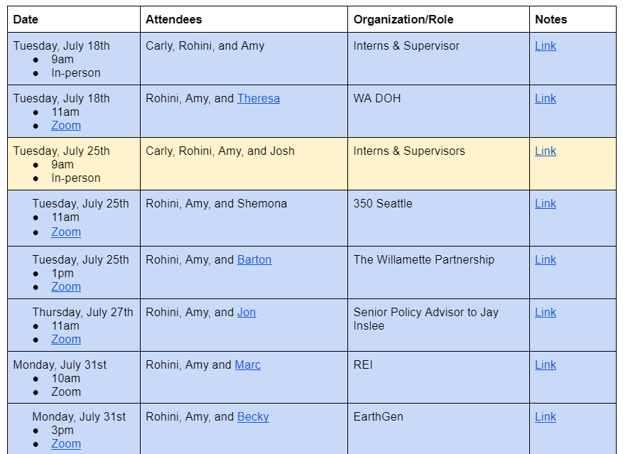
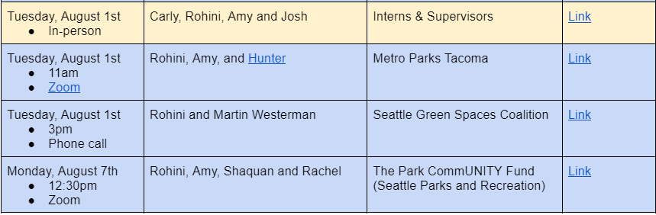
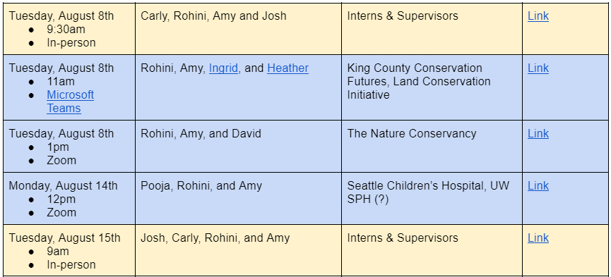
Interviews! (n=12)

Slide 7
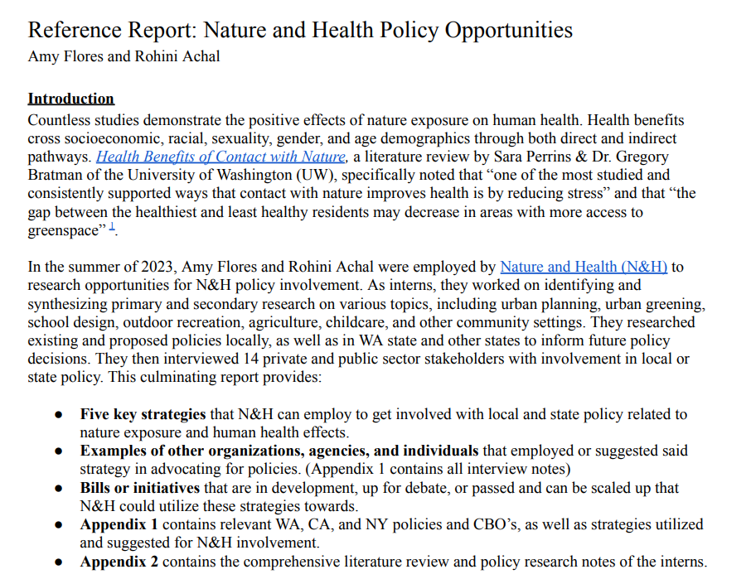




SCAN ME!

Slide 8


3 Main Final Projects!
Nature and Health “reference report” → internal document for our host organization!
This presentation!
Blog post: I wrote a reflective blog post about my internship experience, and it will be published soon! ☺
Notes:
In addition to the main project that Amy and I completed together, I had two other projects that were more reflection based. There is this reflective presentation and then I additionally wrote a blog which will be published on the EarthLab website soon. The blog was about 9 learnings I learned in 9 weeks over my EarthLab internship. Special shoutout to Allie Long who helped me polish it ☺

Slide 9




Reflections
Cohort | Internship Site | Career
Learning style: learning with and from peers! ☺ | Create a relationship with the people you work with | Every job you hold will offer you different talking points and skills
Networking opportunities within the group between peers and with cohort speakers | Stay organized : notes, meetings, research documents, etc. | Take advantage of networking opportunities when they are presented to you!
“Managing up”: take intiatve and communicate questions and ideas | Focus on accessibility: concise scientific communications to empower communities | Career and education paths are not linear
Notes:
Here are my reflections for this internship experience; I tried to break it up into three different categories/tiers of this internship, which was cohort-based learning, the actual internship site, and career/professional development.

Slide 10


Questions?
rohinia@uw.edu

Slide 11


Thanks!
Please keep this slide for attribution

