Slide 1
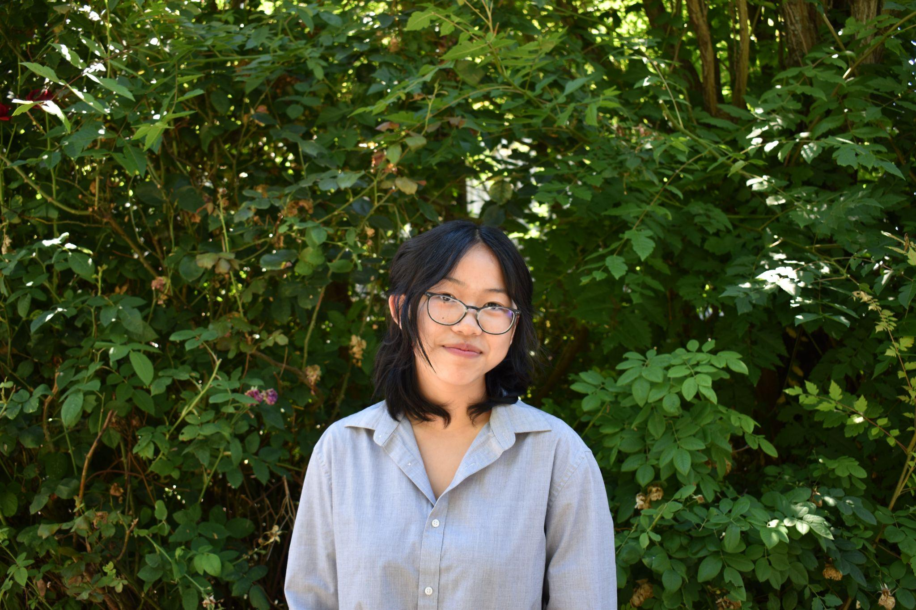
Climate Health Risk Tool Internship @ CHanGE
Aileen Kuang (she/they)
Informatics & Geography @ UW
Notes:
Introduction
Name & pronouns
Climate Health Risk Tool Intern @ CHanGE, with Sophie and Abi
Sophomore @ UW Seattle
Studying Informatics and Geography
Introduce presentation topic: talking about my internship work and reflecting on that work

Slide 2
Why I Chose EarthLab
Before EarthLab
Interest in academia, social justice, user interface/experience design
Passionate about interdisciplinary & transdisciplinary work
Excited (and nervous) about my first internship experience
Eager to learn more about climate change and public health
Notes:
Why I chose EarthLab:
Before EarthLab:

Slide 3
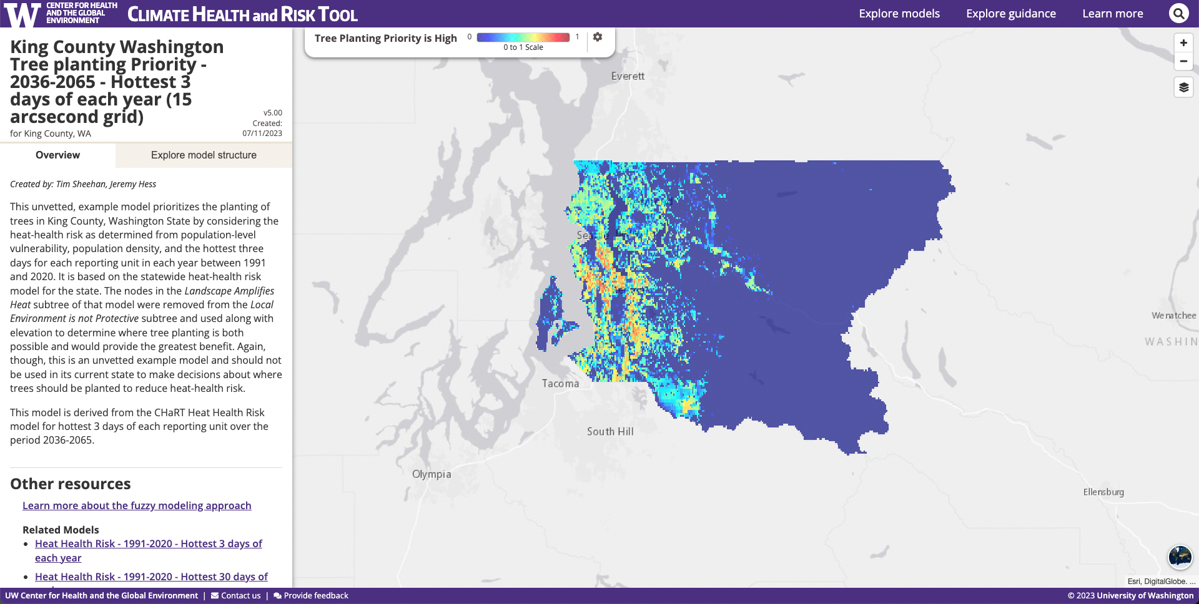
Climate Health & Risk Tool (CHaRT)
What is CHaRT?
Web tool that provides decision makers with information about the impacts of climate issues on people’s health
Uses fuzzy logic modeling
Notes:
Now, I’ll dive into the work I did throughout my internship. As you all have heard from Sophie and Abi, we worked on the Climate Health & Risk Tool, a web tool developed by CHanGE (the Center for Health and the Global Environment) that provides decision makers with information about the impacts of climate issues on people’s health. CHaRT is built on fuzzy logic modeling, which I’ll get into later in my presentation.

Slide 4
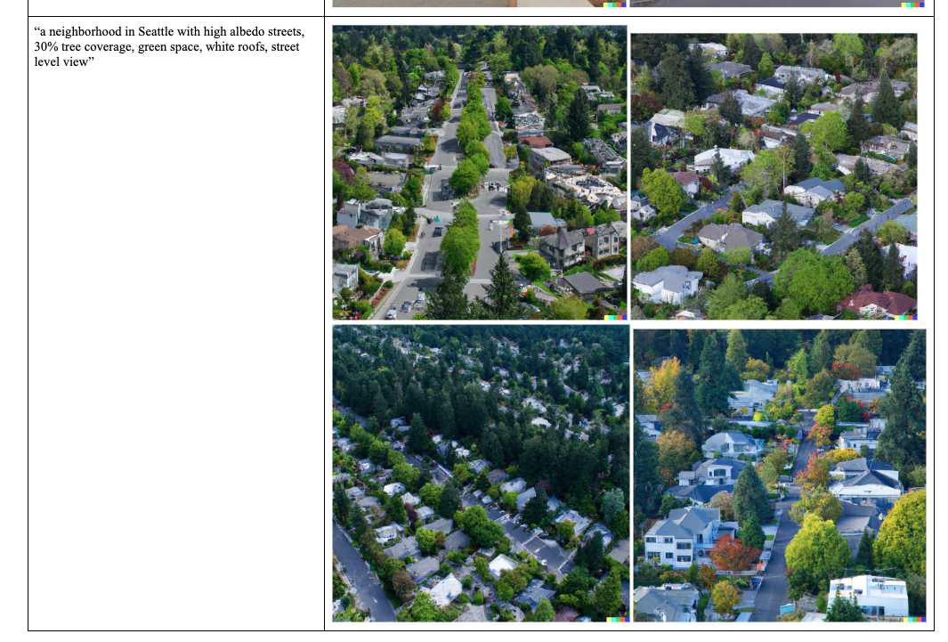

Researching Artificial Intelligence (AI)
Notes:
So, at the beginning of my internship, I started off doing work in user experience design, or essentially trying to figure out how to make the user’s experience with CHaRT smoother. But my supervisor mentioned that they were interested in integrating artificial intelligence into CHaRT, and I decided to work on that! I did some testing with OpenAI’s DALL-E, which is an image-generation AI tool (there are some results to a prompt I inputted on this slide), and I reached out to an organization in Canada that was doing similar climate-health work but with AI. I learned a LOT about AI, but I also learned a lot about myself: I learned that I was a lot more interested in working with data and AI than doing design work.

Slide 5
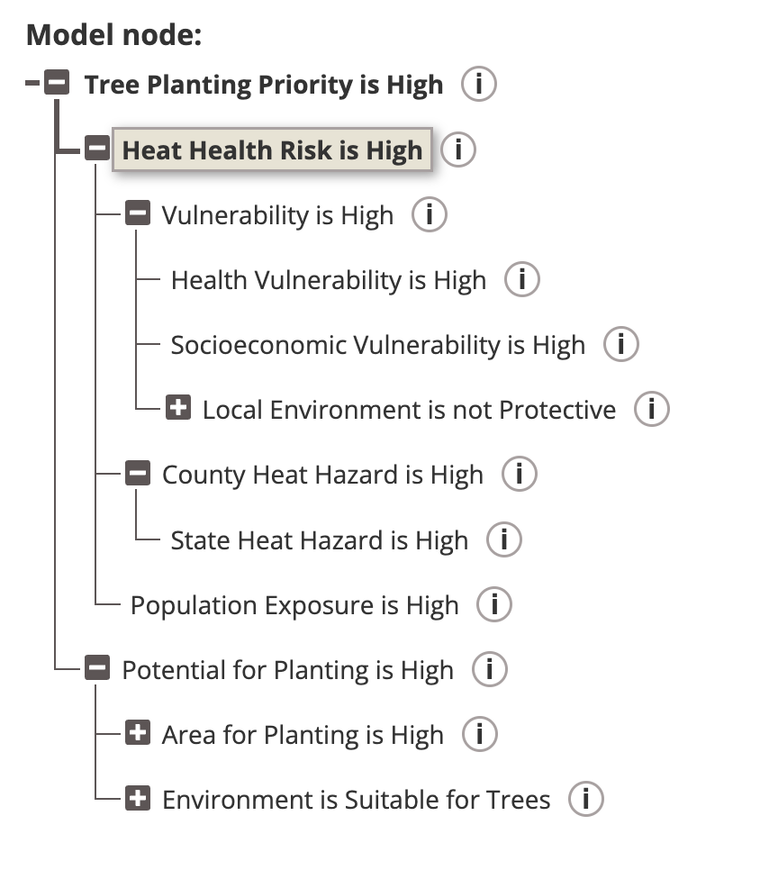
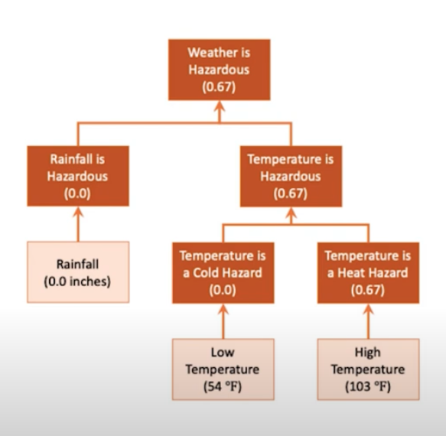
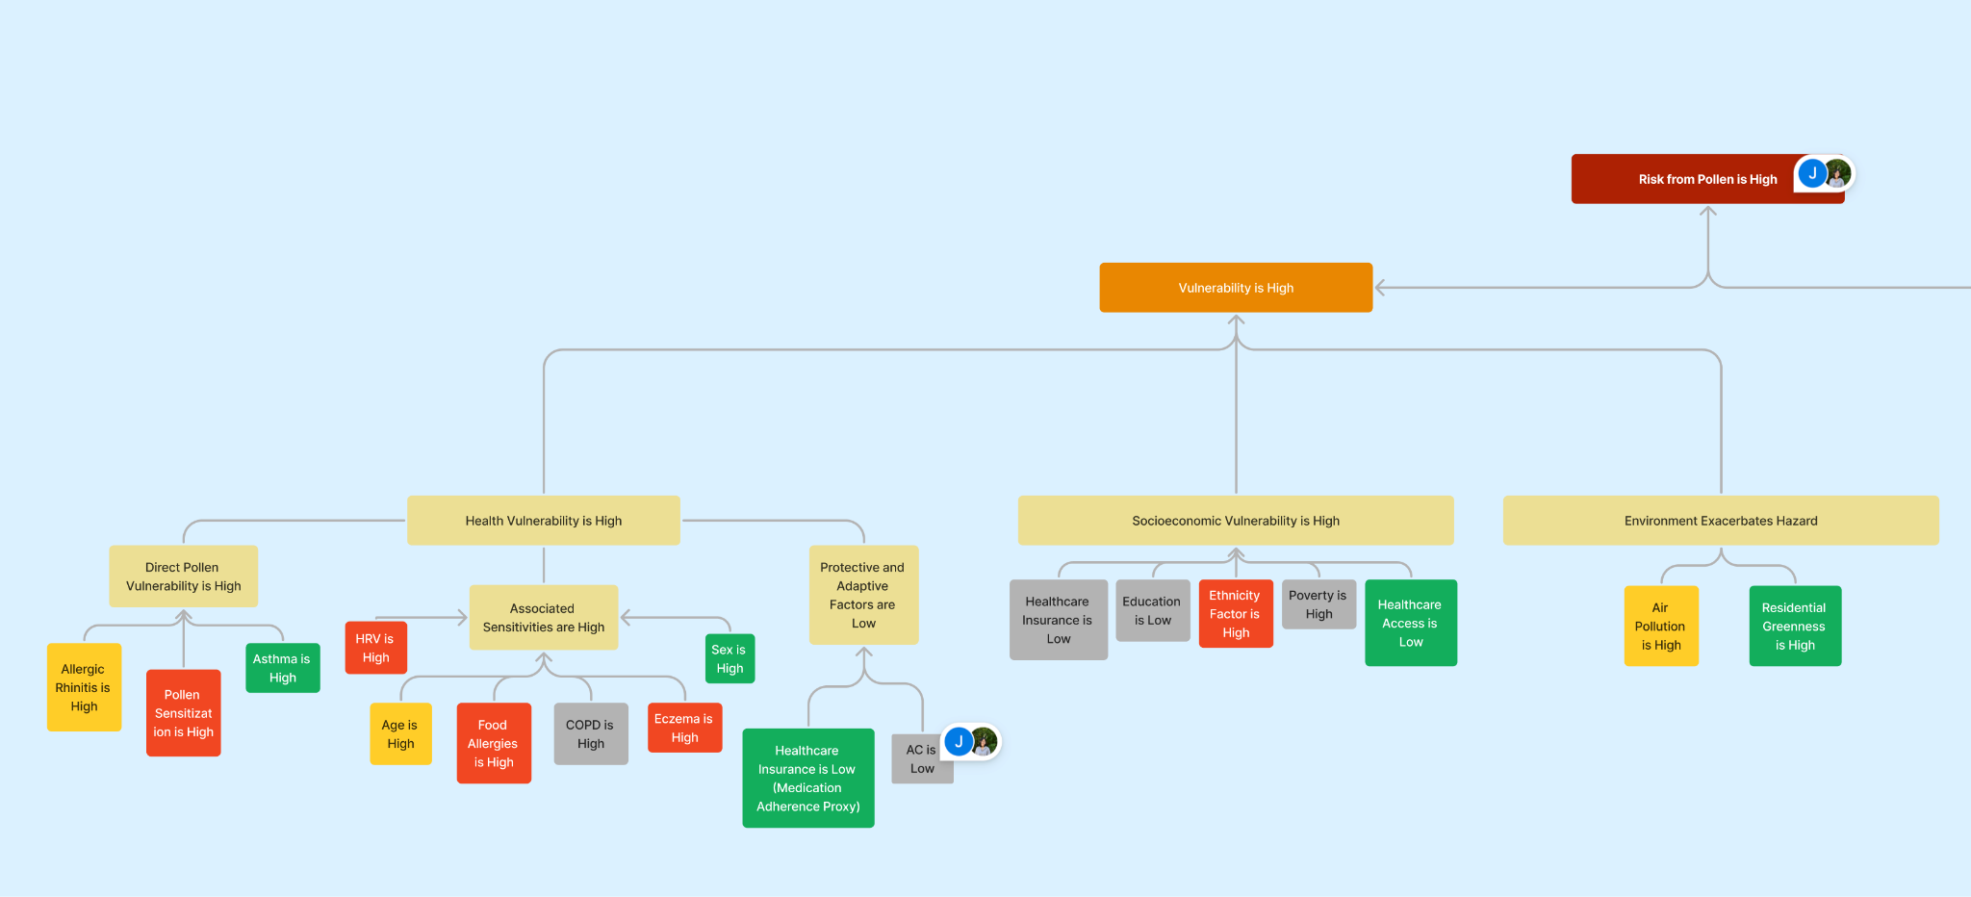
Pollen Health Risk Model
Pollen health risk
Fuzzy logic modeling
Notes:
This leads me to one of the other projects I worked on throughout my internship: CHanGE’s pollen health risk model. It’s a little bit self explanatory: this model will illustrate pollen health risk, which is increasing as a result of climate change.
I worked with fuzzy logic modeling, which is what all of the CHaRT models are built on. I’ll just provide a high-level overview of what fuzzy logic modeling is ‒ essentially, fuzzy logic models are used to illustrate the strength, or truth, of a statement on a scale of 0 to 1, with 0 being not very strong, and 1 being very strong.
With fuzzy logic modeling, I developed a conceptual framework for the pollen health risk model, which is here on the slide!

Slide 6
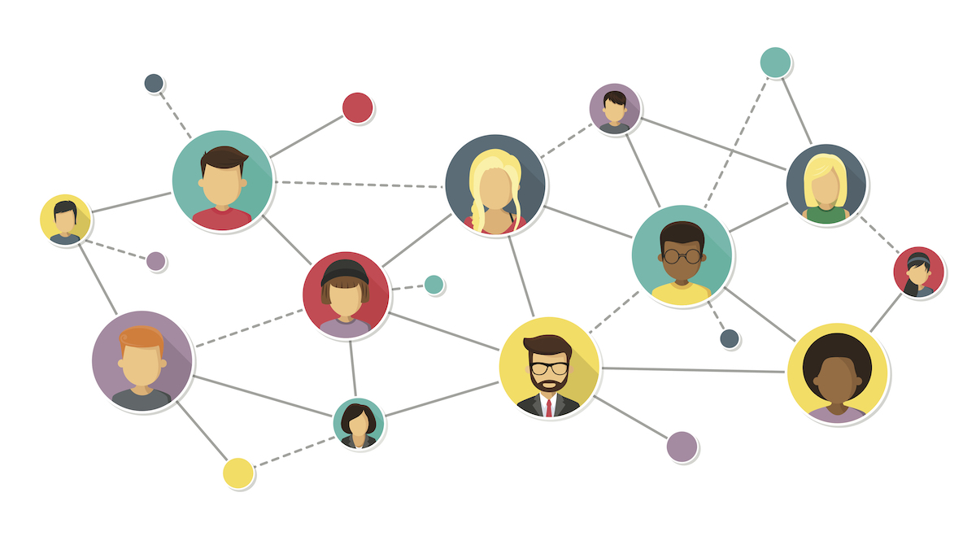

What I learned:
Gotten better at networking
Learned to collaborate with others in a professional setting
Learned how to balance work with other aspects of my life (school, social life)
Figured out that I’m more interested in data science than user experience design!
Notes:
So, I’ve done a lot of things during this internship, and it has been a valuable experience for me ‒ not only professionally, but personally.
Learning to network and generate connections ‒ people are a lot more interested to connect with you than I thought they were
Learning that maybe my interests don’t lie in UI/UX, but in data science :)
Being comfortable with not knowing things
Figuring out how to balance my work with other aspects of my life, like school and friends

Slide 7
Special thanks to my cohort, the EarthLab team, and CHanGE: especially:
Lissan Tibebe, Jeremy Hess, Tim Sheehan, Sophie Li, Abi Chinn
Notes:
Finally, I want to give a special thanks to my EarthLab cohort, the EarthLab Team, and CHanGE, especially Lissan Tibebe, Jeremy Hess, Tim Sheehan, Sophie Li, and Abi Chinn, for their support throughout this experience.

