Slide 1
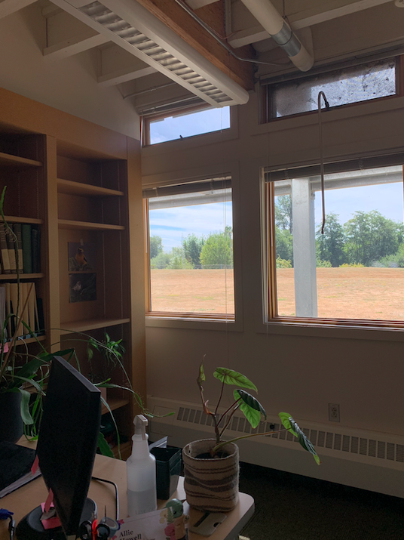
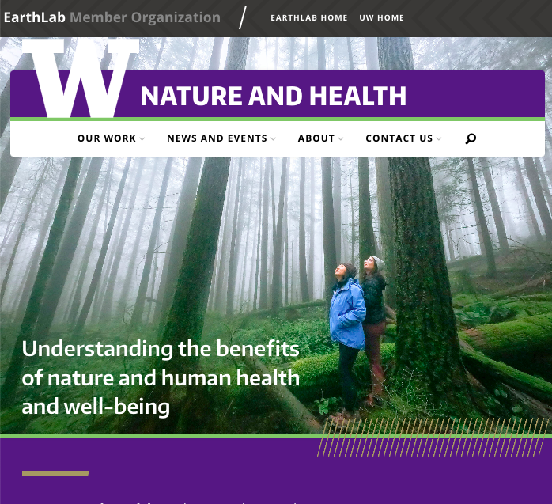
Nature and Health Policy Internship
Amy Flores (she/her)
2023 Public Health - Global Health Graduate

Slide 2

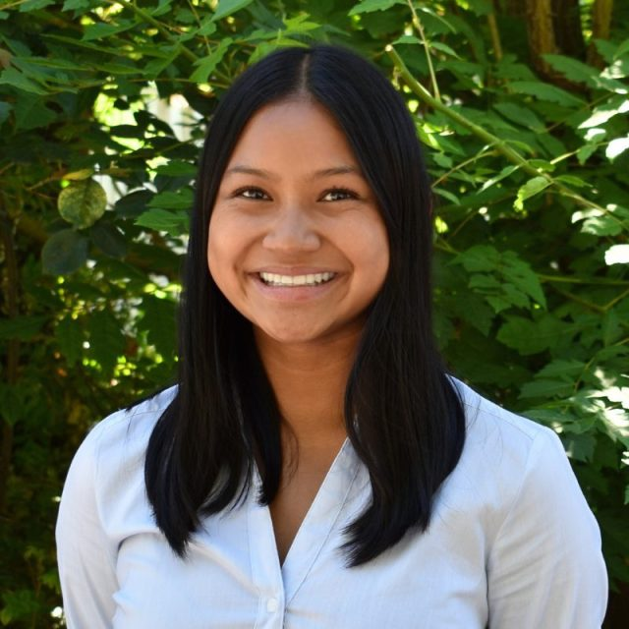

About me:
Notes:
Grew up in WA with constant love and exposure to the outdoors.
Always traveling, taking road trips, exploring with family.
Drove a passion for studying the environment and its health impacts.
I’ve always been interested in how climate change continues to affect us and what we are doing to mitigate its impacts.
My public health work has deepened my interest in environmental health and equity in the midst of addressing climate change.

Slide 3


Why EarthLab/Nature & Health
I was attracted to EarthLab and its values and mission
Applying my policy knowledge/experience from past classes.
Excited to share my knowledge and experience as a recent grad with my cohort.
Eager for the opportunity to start my internship with N&H by learning what was out there.
Notes:
Mission: to address climate related issues and its intersection with social justice.
Researching the health benefits of spending time with nature.
Policies that are aiming to increase these benefits in a equitable manner.

Slide 4

About Nature & Health
Position
Duration
9-Week internship with weekly cohort meetings
Nature and Health Policy Intern with Nature and Health.
Notes:
Nature & Health
One of the UW EarthLab partner organizations “seeking to understand the connections between nature and human health and well-being.”
Nature and Health works to translate that understanding to different programs, practices, policies, and the design of healthcare, education, and community settings that benefit all people and nature.
Connect research with practitioners, policy makers, and other community members to encourage collaborative efforts that address needs of communities.

Slide 5
Internship Timeline
Weeks 1-4
Weeks 4-8
Weeks 8-9
VENUS
Literature review on impacts of nature and health.
Policy Research (local, state, federal levels)
What other organizations are doing & how we can help.
Drafting interview questions
Interviews!
We conducted 12 interviews with 14 different individuals/organizations
Final Project Synthesis identifying policy opportunities for Nature and Health involvement!
JUPITER
MARS
Notes:
1-4: Chance for Rohini and I to learn more about what was out there - research side of things - what are the health benefits and impacts of time spent in nature
We learned more and were both passionate about mitigating green gentrification which is implementing a green space into an area or community, making that area more appealing, ultimately driving those who live there out. And we were eager to ask those involved in policy what they thought can be done about this issue to increase equity in access to nature and its many health benefits
4-8: interviewing individuals and organizations involved in policy: ranged from environmental advocacy organizations to a senior policy advisor in the governor's office and they all gave us great input on our final project which was
8-9: identifying policy opportunities for Nature and Health as an organization to become involved in

Slide 6


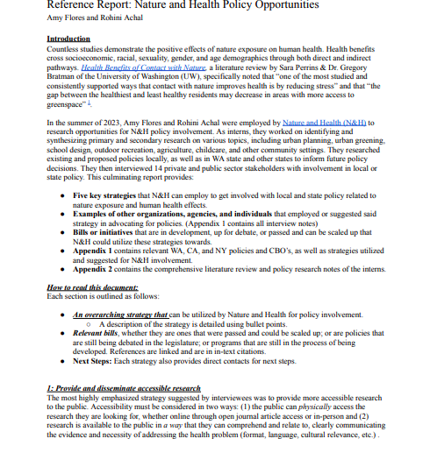
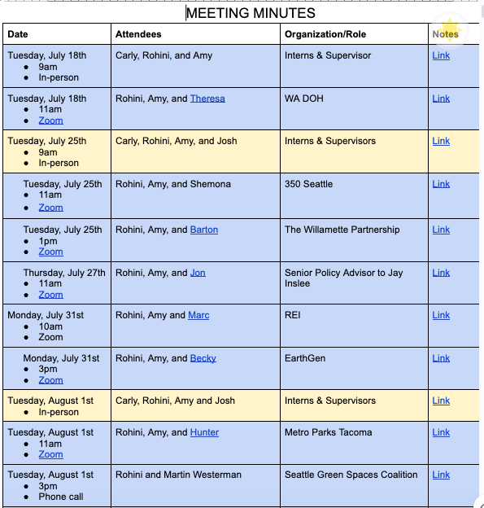
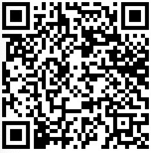
About the Internship
Notes:
5 strategies N&H policy opportunities we pointed out was: (1)providing accessible research that can be easily be shared and understood by the public, (2) providing expert opinion, (3) supporting assisting communities with grant application assistance, (4) supporting diverse and new research studies, (5) re-introducing N&H networking opportunities for community members and partner organizations

Slide 7
Challenges:
Staying organized!
Communicating professionally with individuals in their field - very different from school experience.
Preparing for interviews
Staying self productive and motivated!

Slide 8
Reflection
Written, communication, and organizational skills!
Reminded of my love for the environment and the dire need to preserve it.
Learned so much valuable information about policy but it may not be for me.
Excited to shift my focus towards studying the environment and the effects of climate change through post-grad education in Environmental Science.
Moving forward, taking experiences from cohort meetings and interviews - reminded of the importance of discussing climate issues with others and hearing their thoughts.

Slide 9
Thank you to everyone at EarthLab, Nature and Health, and my cohort, especially:
Josh Lawler
Carly Gray
Rohini Achal
Lissan Tibebe
Anastasia Ramey Ben Packard

Slide 10
Questions?

