Slide 1
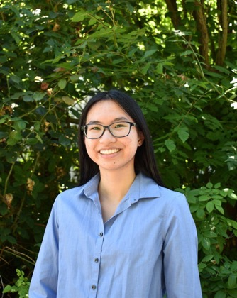

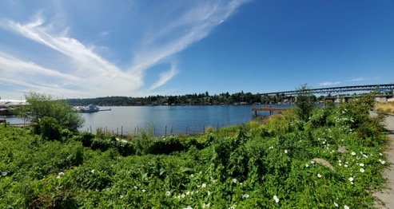
Abi’s Showcase
Presentation
• Pronouns: she/her
• Year: 3rd
• Major: Geography: Data Science (and hopefully Informatics)
• Minor: Urban Design and Planning
• Internship: Climate Health Risk Tool Intern @ the Center for Health and the Global Environment (CHanGE)
Notes:
• Did your idea of climate justice change over the course of the internship?
• Which topics or speakers were the most interesting and impactful to you?
• How did the cohort sessions affect your experience with the host organization?
• Did your future aspirations change over the 9 weeks? If so, how?

Slide 2
Why I Applied
CHanGE (Center for Health and the Global Environment) offered me the opportunity to create tangible and real-world effects by helping people reduce health risks from global environmental change.
Internship had a technological aspect to it, working with CHanGE’s decision support platform, CHaRT (Climate and Health Risk Tool), combines a vulnerability and risk mapping tool with location-specific guidance for reducing health risks from climate change.
Notes:
What interested you about the internship placement itself and/or environmental or climate justice more broadly?

Slide 3
What is the Center for Health and the Global Environment (CHanGE)?
CHanGE exists to highlight the connections between climate change and human health. CHanGE’s work is ultimately aimed at promoting the health benefits of climate action, including the preparedness and response to climate change impacts (adaptation). CHanGE also works to highlight the importance of weather and climate in population health and to provide the health sector with knowledge, tools, and capacity to incorporate climate awareness and resilience into all of its activities.

Slide 4
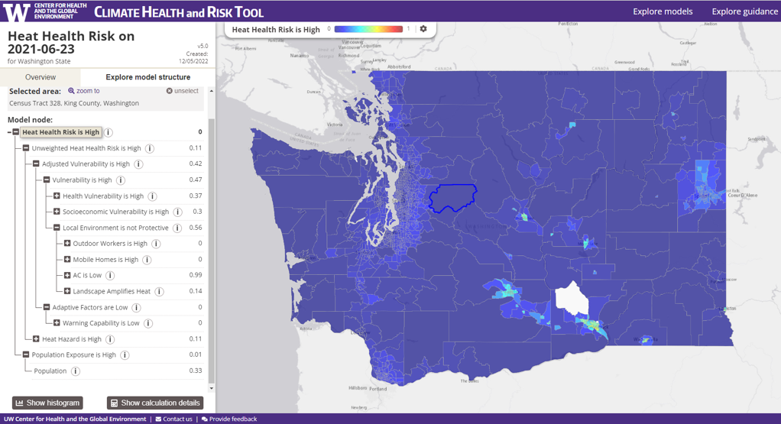
What is CHaRT (Climate and Health Risk Tool)?
[climatesmarthealth.org/]
Interactive, web-based tool to explore how a variety of climatic, environmental, social, and economic factors contribute to climate-related health hazards.
Decision support models can help us understand and explore the mechanisms, magnitude, and location of disproportionate impacts to develop more informed plans to protect community health under changing climate-related. environmental conditions.
Exposes the level of health risk to climate hazards and exposes the factors that drive that risk.
Screenshot of a census tracts heat health risk in the model
Notes:
In the CHaRT Heat Health Risk model, heat is the hazard. Vulnerabilty is a combination of health, socioeconomic, and biophysical factors that make people exposed to heat more vulnerabile to its detrimental health effects. Exposure is the population, (i.e. number of people within a reporting unit).
The model is implemented using fuzzy logic. A fuzzy logic model is a hierarchical, bottom-up model in which data sets are read in at the bottom-most, or leaf, nodes. Data from each leaf node are transformed to a 0 to 1 scale (referred to as fuzzy space) to create a bottom-level fuzzy node. Fuzzy nodes are then combined, based on their relationships to one another, into higher level fuzzy nodes, always on a 0 to 1 scale, until there is a single, top-level node. For this model that node is Heat Health Risk is High.
combines a vulnerability and risk mapping tool with location-specific guidance for reducing health risks from climate change.
Decision makers and community members need information about how climate-related environmental hazards like heat, storms, flooding, drought, and wildfires are likely to impact people's health.
These hazards disproportionally affect some communities more than others. Decision support models can help us understand and explore the mechanisms, magnitude, and location of these impacts in order to develop more informed plans to protect community health.
The Climate Health and Risk Tool provides an interactive way to explore how a variety of climatic, environmental, social, and economic factors contribute to climate-related hazards faced by communities. This information helps decision makers and community members develop plans to protect communities and public health under changing climate-related environmental conditions.
Explore how a variety of factors contribute to climate0related health hazards

Slide 5
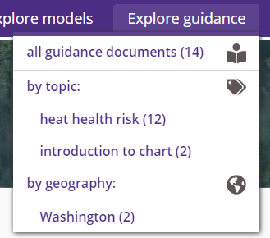
What I Worked On
Different, small items — researching different tools and thinking about implementations for CHaRT
Article for CHanGE website about heat costs, telling them about heat-related illness and death and CHaRT; about the cost effectiveness of interventions for heatwaves and how guidance around interventions needs to be prioritized
  Interventions: fans, air conditioning, tree cover and greenspace, etc.
Putting together data from CHaRT for a report generation for legislative districts
Notes:
What was the main project you were working on?
○ What did you do?
○ Were there any significant accomplishments that you would like to share?
● Who did you work alongside?
● What were you most excited about working on?
CHanGE’s decision support platform, CHaRT (Climate and Health Risk Tool),
When you look at costs of heatwaves and interventions, most if not all are cost effective - there is strong cost benefit case to be made but what we need is guidance around interventions to be priritzed where and viola CHaRT
heat is dangerous causing illness and death, illness and death can be valued, work done shows excess mortality related to heat

Slide 6
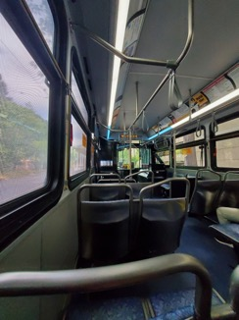
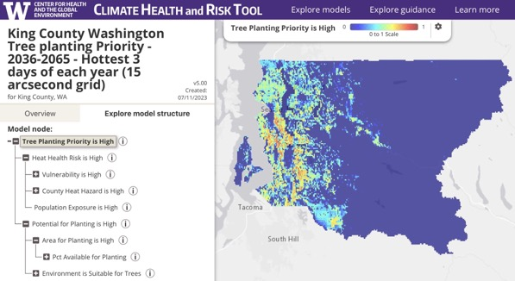
Reflection
Remote pros and cons
  No commuting
  Creating my own space
  Connection with others
Take charge in my own work
Path does not need to be linear
CHaRT + technology’s power + power of maps
Notes:
Many roles
● What did you learn about yourself?
● How did you grow personally and/or professionally as a result of this experience?
● What will you take from this experience moving forward?
● What’s next for your academic and/or professional career?
Where do you see yourself in 5 or 10 years?

Slide 7
Thank you to everyone at EarthLab, CHanGE, and my cohort!

